Slide 1

Supporting Decision Making under Deep Uncertainty
Prof. dr. ir. Jan H. Kwakkel
Multi-Actor Systems department
Faculty of Technology, Policy and Management

Slide 2
So what is deep uncertainty?
Deep uncertainty refers to the situation where the various parties to a decision do not know or cannot agree on
The system model that relates actions to consequences
The prior probability distributions to put on the inputs to the system model(s)
Which consequences to consider and their relative importance
Deep uncertainty often involves decisions made over time in dynamic interaction with the system.
Kenneth Arrow first used the term in the late 1990s to characterize the climate change debate
Formal work on dealing with deep uncertainty started in the early 2000s at the RAND Corporation and TU Delft.
Deep uncertainty is also known as radical uncertainty, Knightian uncertainty, or uncertainty proper

Slide 3
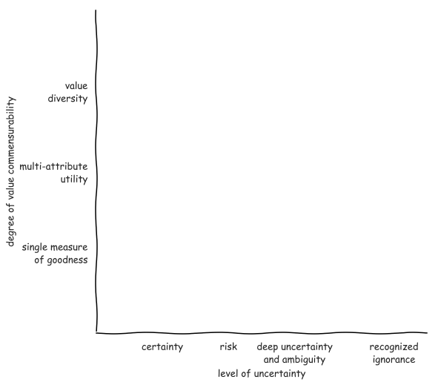
Notes:
Pas op met woord methode
Ontbreken van theorie en effectieve methode

Slide 4
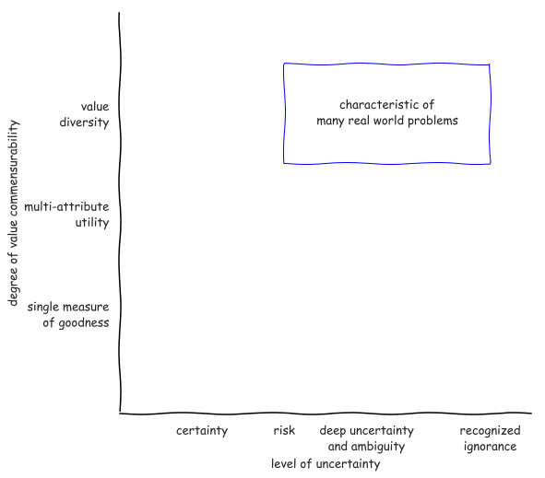
Notes:
Pas op met woord methode
Ontbreken van theorie en effectieve methode

Slide 5
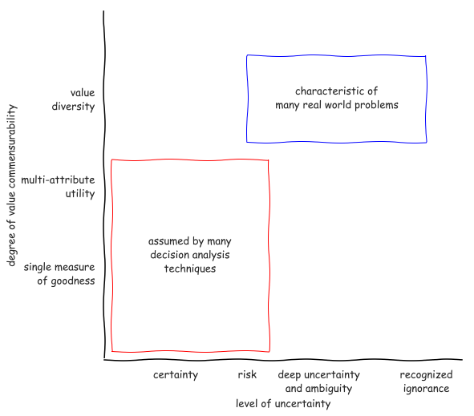
Notes:
Pas op met woord methode
Ontbreken van theorie en effectieve methode

Slide 6
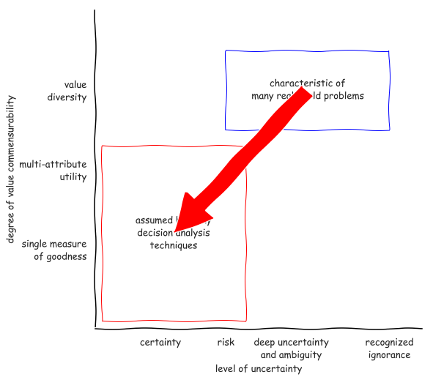
Notes:
Pas op met woord methode
Ontbreken van theorie en effectieve methode

Slide 7
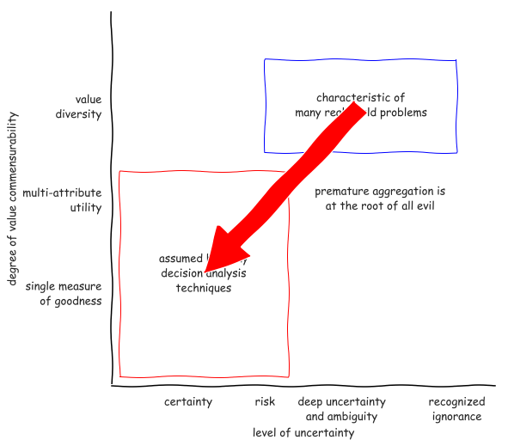
Notes:
Pas op met woord methode
Ontbreken van theorie en effectieve methode

Slide 8
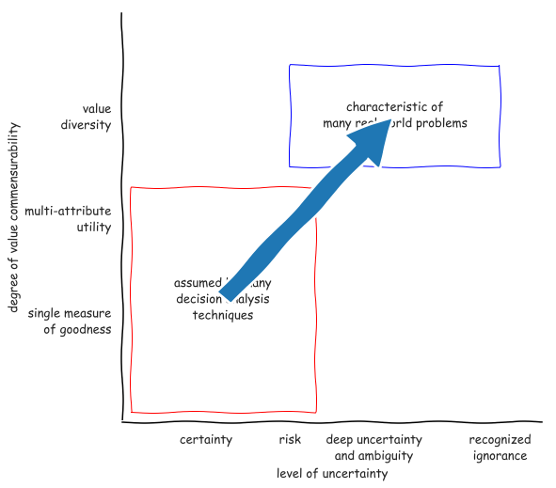
Notes:
Pas op met woord methode
Ontbreken van theorie en effectieve methode

Slide 9
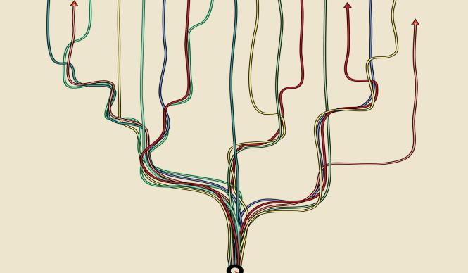
Why use models?
Argument from complexity
supplement human reasoning
sensitivity to initial conditions
Argument from uncertainty
When confronted with uncertainty, instead of making an assumption, explore the consequences of alternative assumptions systematically to identify differences that make a difference
Notes:
Multiplicity of legitimate perspectives
Does l’esprit de geometrie have a place?

Slide 10
Decision-making under deep uncertainty
Decision aiding – the aim of decision advise is to facilitate learning about a problem and potential courses of action, not to dictate the right solution. This entails a shift from a priori to a posteriori decision analysis.
Adaptive planning – plans should be designed from the outset to be adapted over time in response to how the future is unfolding
Exploratory scenario thinking– the future is uncertain and cannot be probabilistically constrained, we need systematic what-if analysis of the future which serves as a test bed for candidate strategies

Slide 11
Aiding decision making

Slide 13
Adaptive planning

Slide 15
Exploratory scenario thinking

Slide 16
How to use models to design pathways?

Slide 17
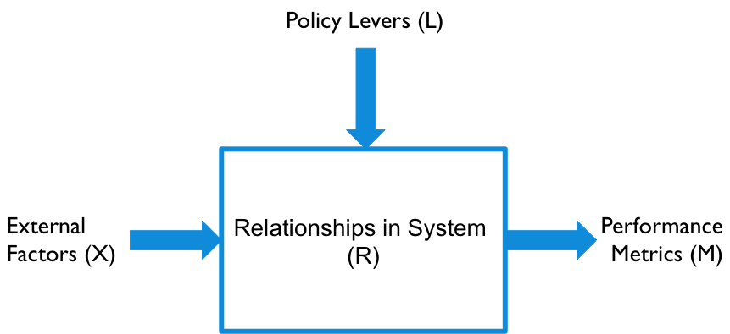
XLRM framework

Slide 18
Running a model as a function
X : uncertainties
Model structure uncertainties as well as exogenous forces
A point in uncertainty space is called a scenario
L : levers
A point in lever space is called a policy
Policies to be tested over the uncertainties
M : outcomes
Outcomes of interest

Slide 19
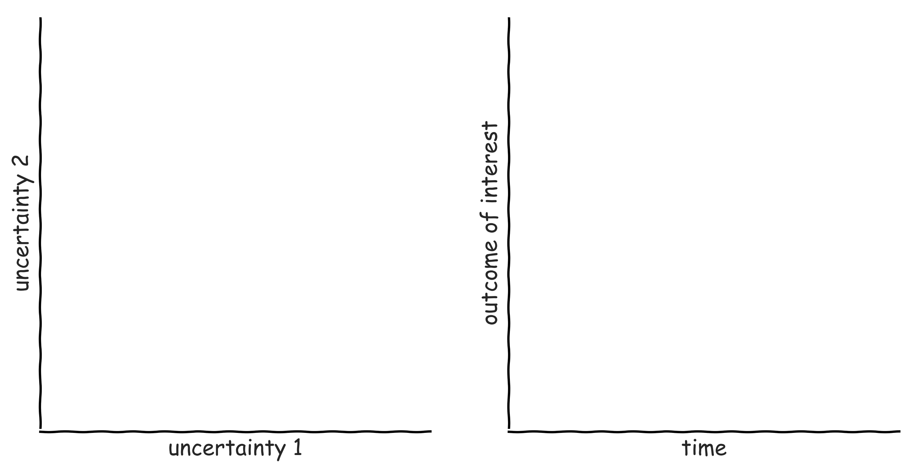
Exploratory modelling in a nutshell

Slide 20
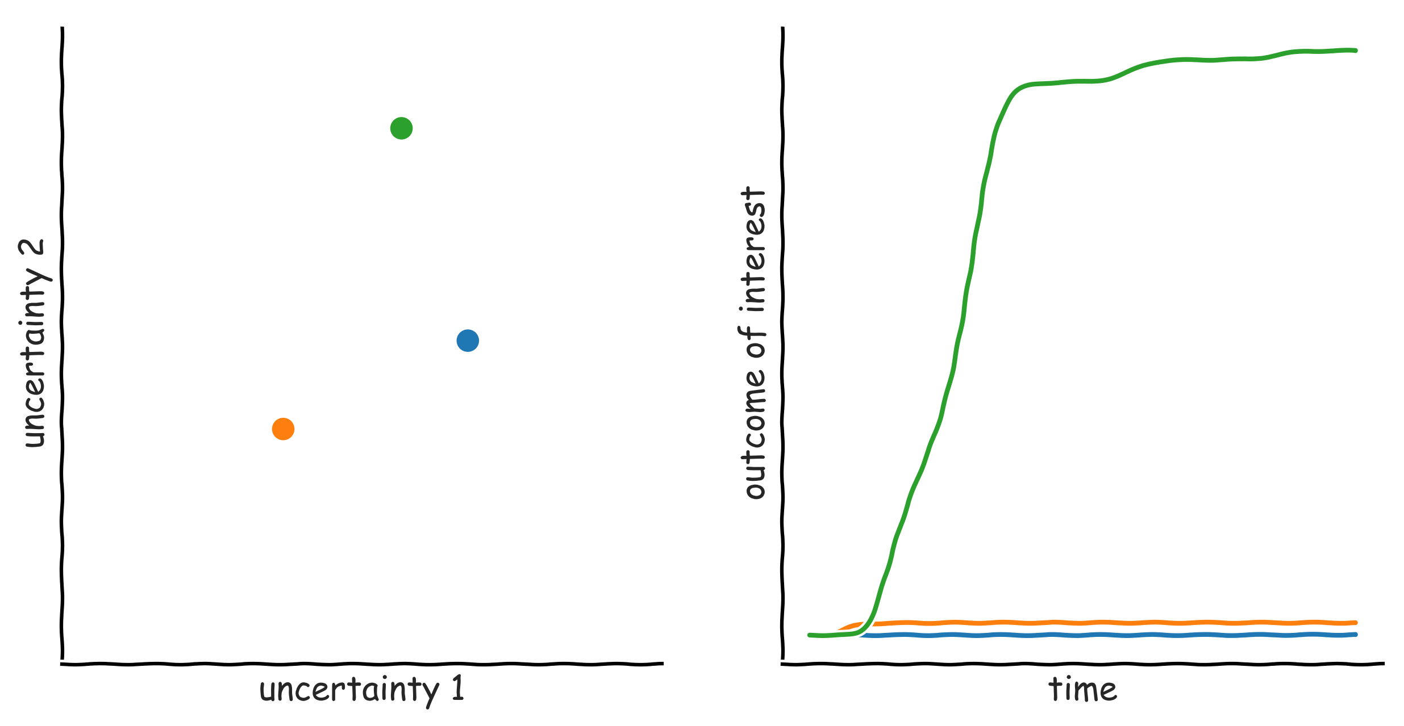
Exploratory modelling in a nutshell

Slide 21
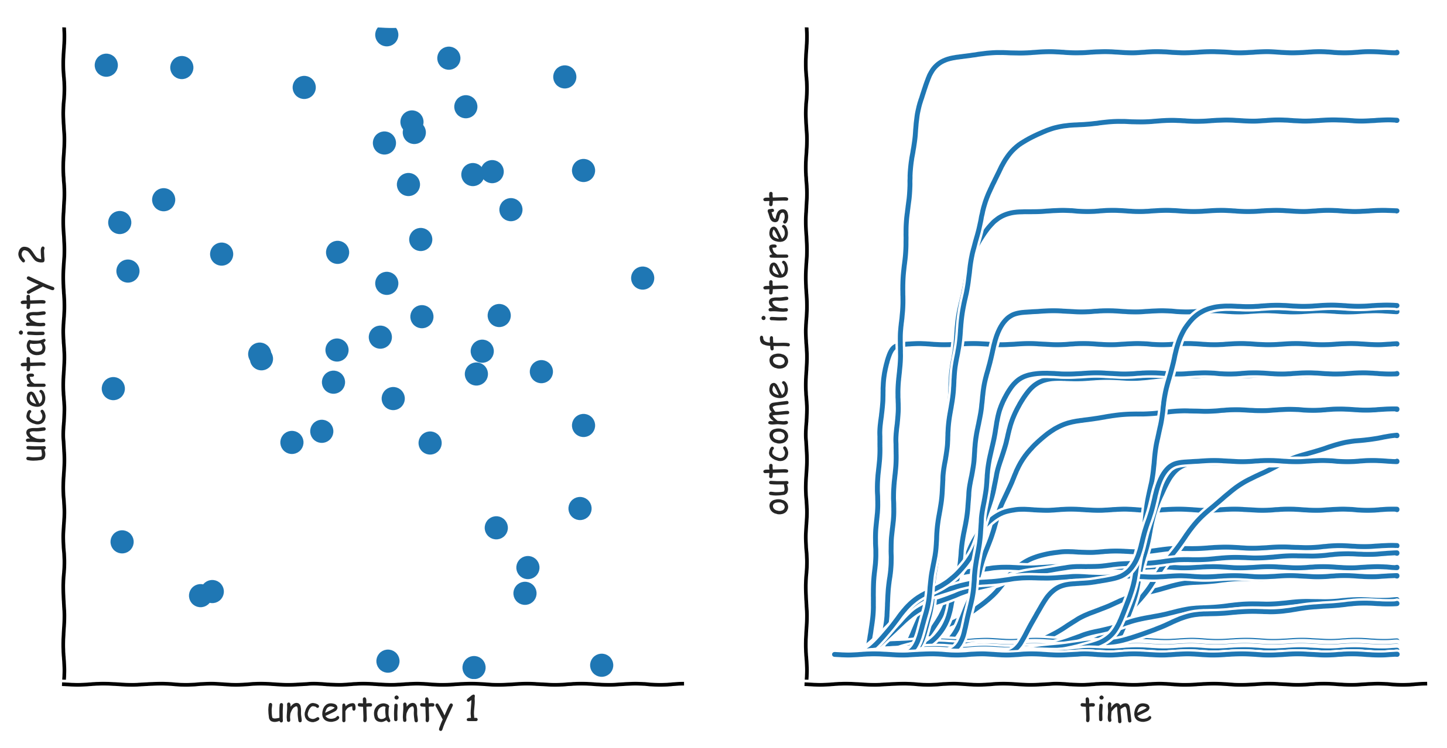
Exploratory modelling in a nutshell

Slide 22
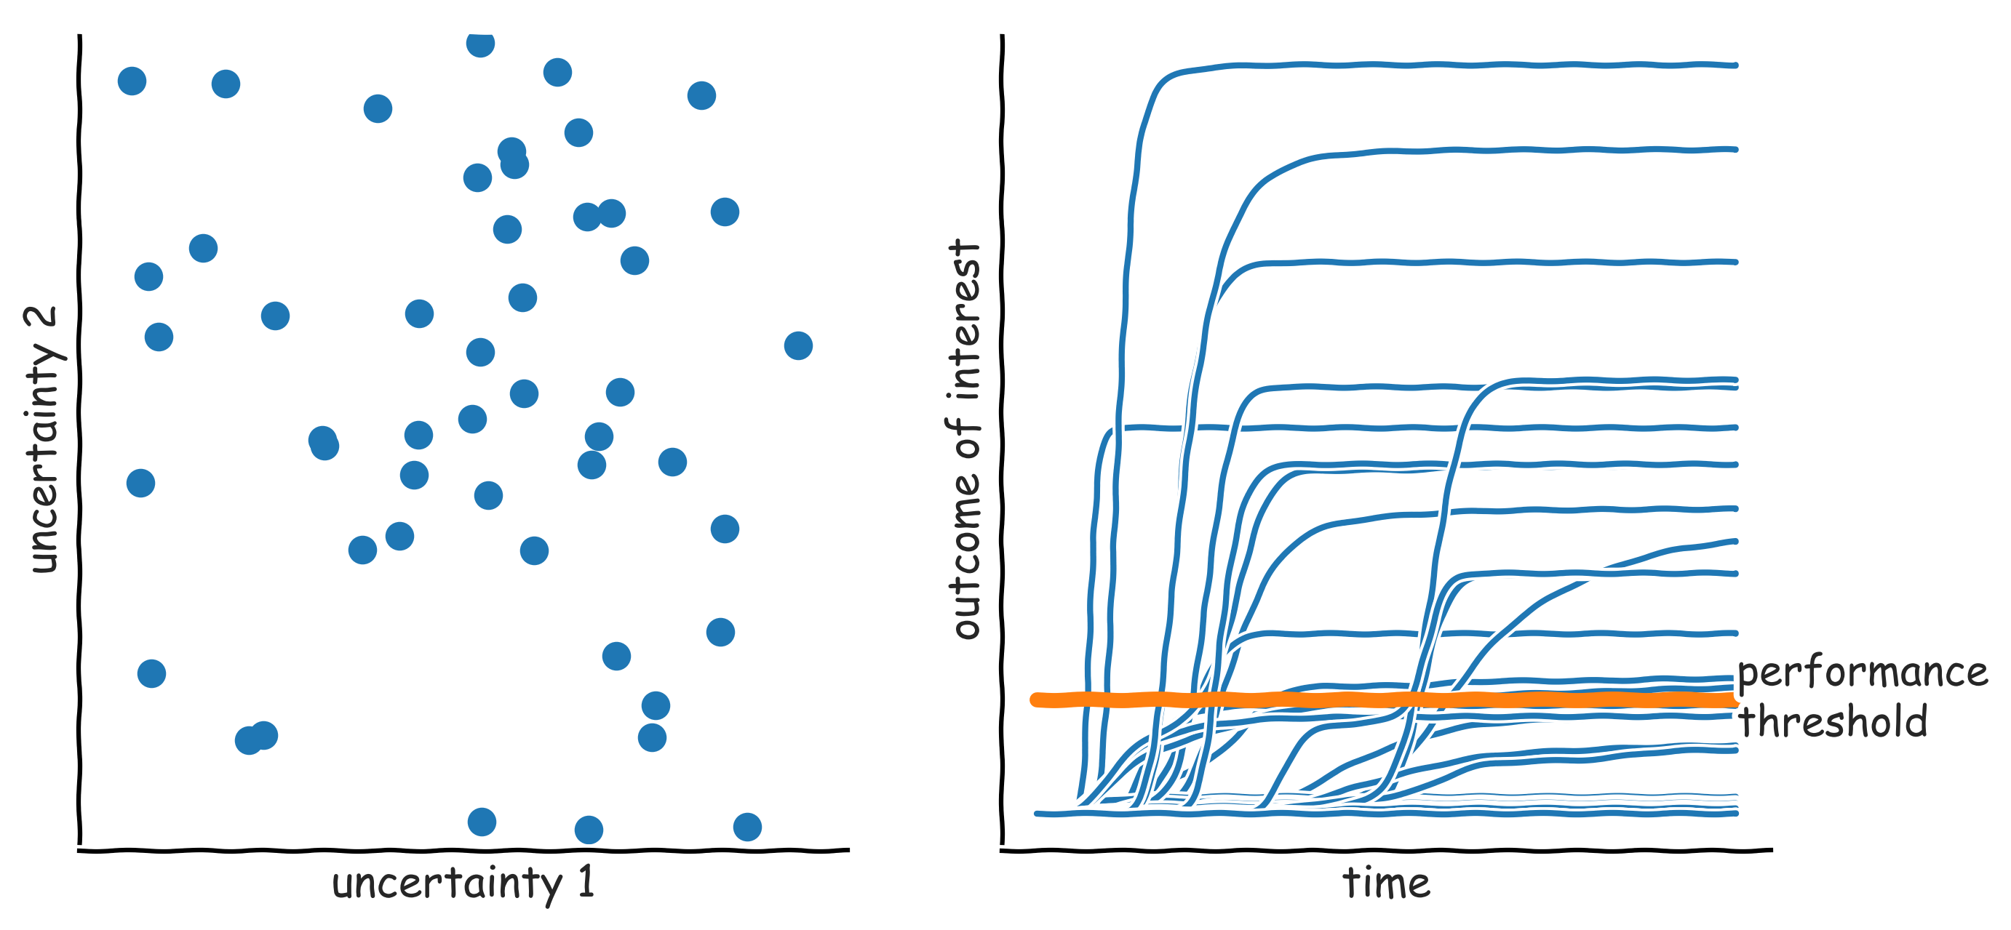
Exploratory modelling in a nutshell: scenario discovery

Slide 23
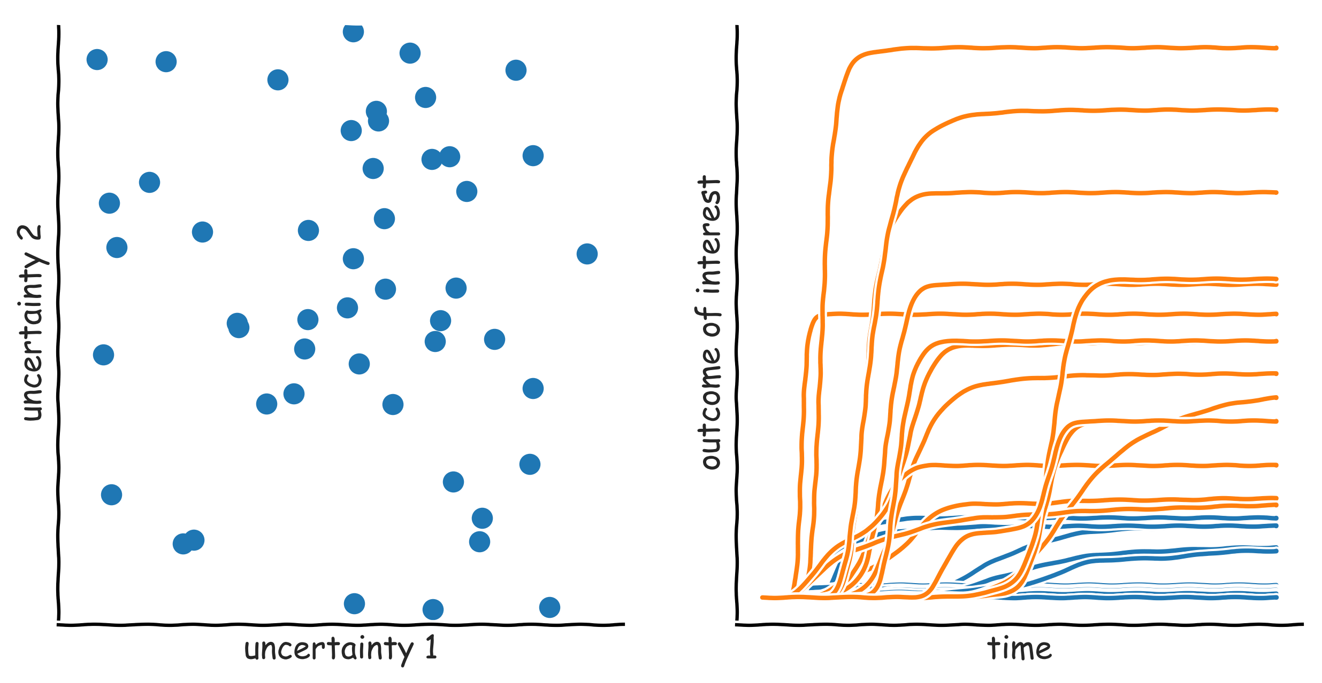
Exploratory modelling in a nutshell: scenario discovery

Slide 24
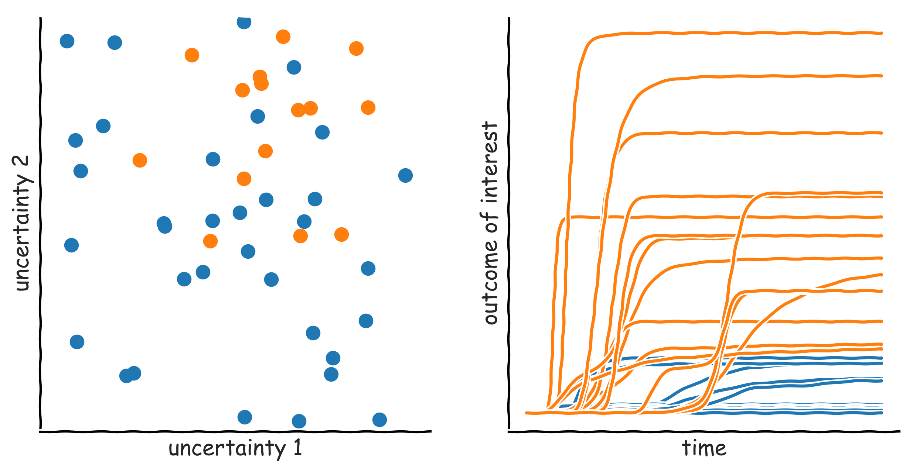
Exploratory modelling in a nutshell: scenario discovery

Slide 25
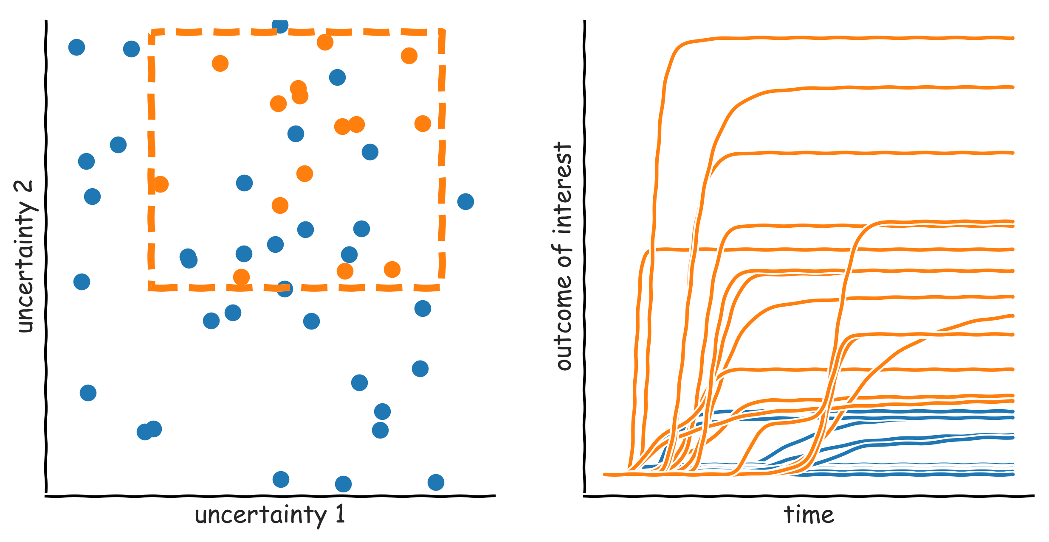
Exploratory modelling in a nutshell: scenario discovery

Slide 26
Manual scenario discovery exercise

Slide 27
Getting started with google colab

Slide 29
Scenario Discovery

Slide 30
Subspace partitioning
Problem: find an (orthogonal) subspace in the model input space, which has a high concentration of cases of interest
Rule induction problem
Regression vs. (binary) classification
Rule induction algorithms
Classification and Regression Trees (CART)
Patient Rule Induction Algorithm (PRIM
Various other more specialized possibilities

Slide 31
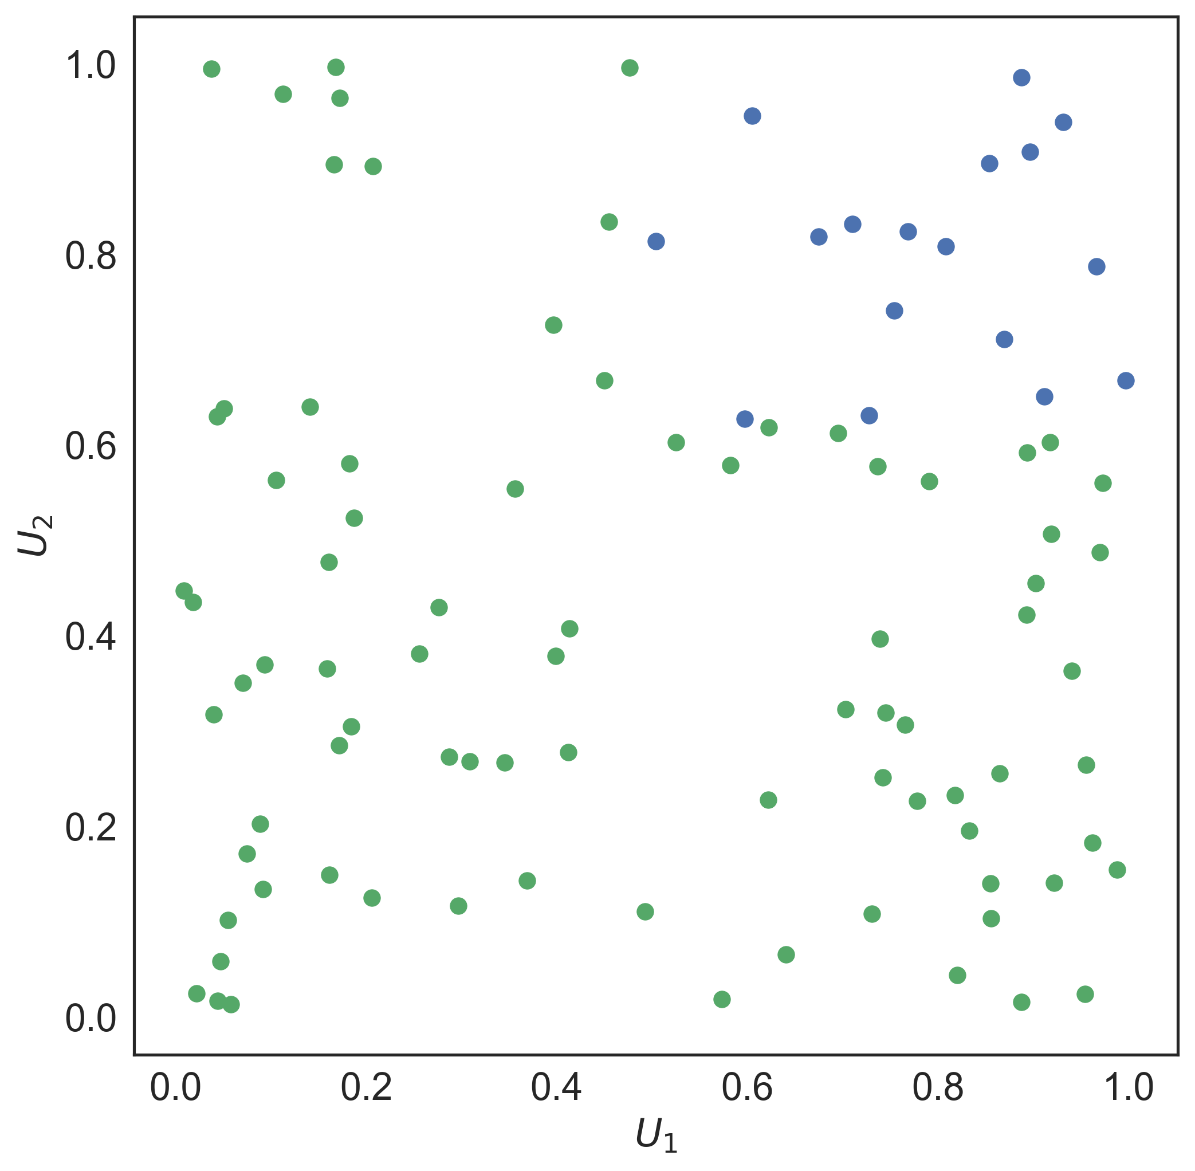
PRIM

Slide 32
PRIM
Lenient hill-climbing optimization algorithm
Each step in the optimization is stored → peeling trajectory
Coverage: fraction of cases of interest within the box
Density: fraction of cases in the box which is of interest
Interpretability: number of restricted uncertainties
Quasi p-values: one sided binomial test, proxy for statistical significance of each restricted uncertainty in isolation
Resampling statistic: do random subsets of the same dataset produce essentially the same box?

Slide 33
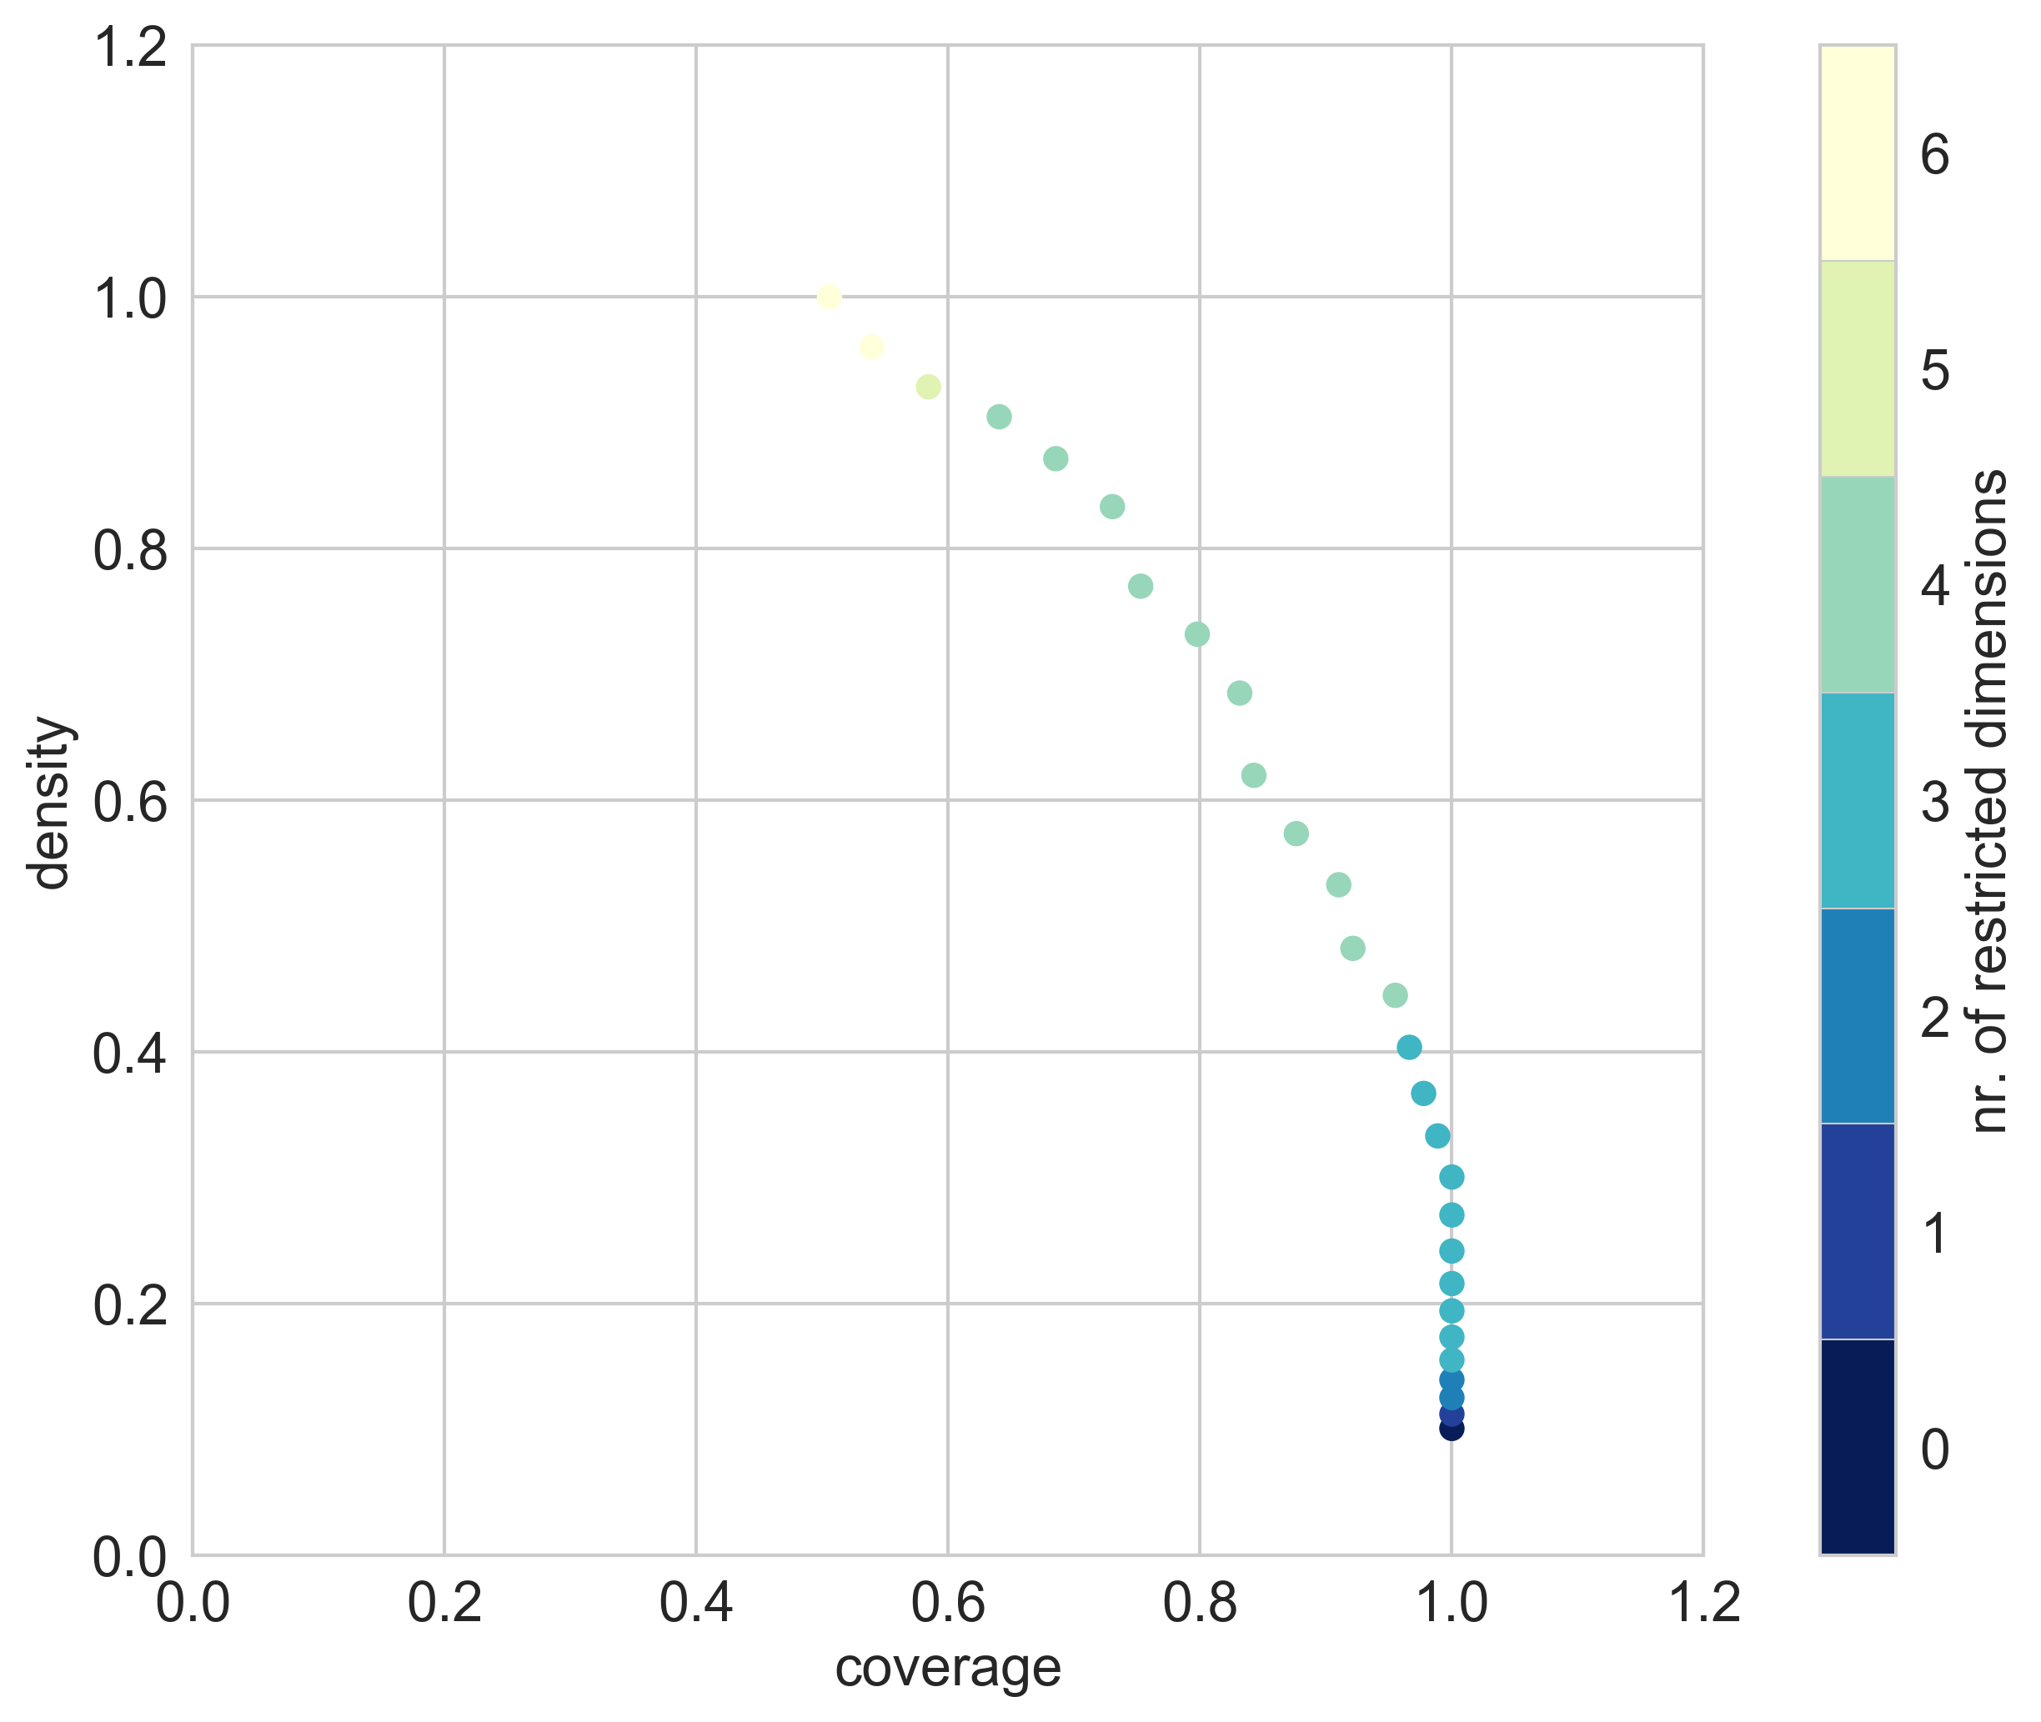

Slide 34
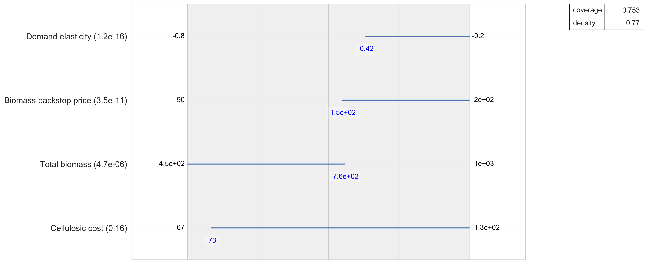

Slide 35
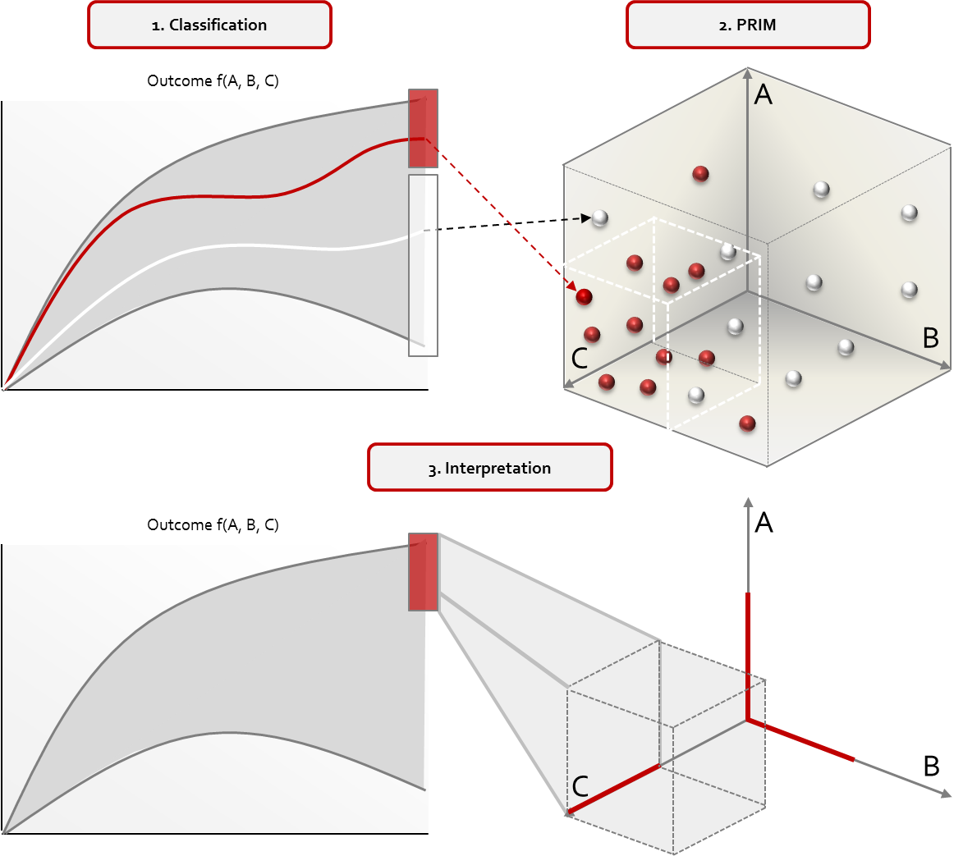
Scenario Discovery

Slide 36
Link scenario discovery results to adaptation tipping points

Slide 37
Scenario Discovery excercise

Slide 40
Introduction to MORDM

Slide 41
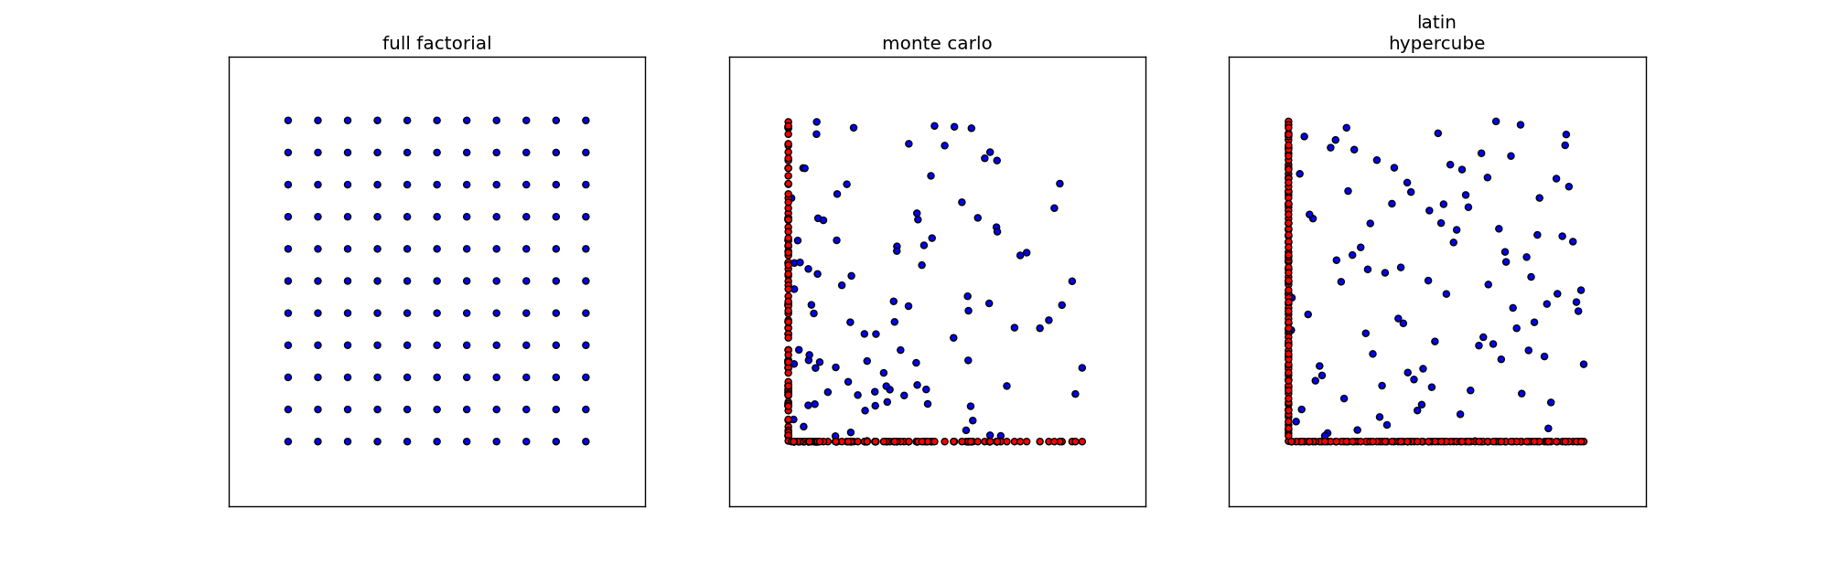
Experimental designs
Notes:
Figures show three sampling strategies with same number of samples (100)
For latin hypercube and monte carlo the red dots show the difference
Problem with full factorial is combinatory explosion.
Problem with lhs is generating it for many cases is memory intensive

Slide 42
Ruit plaatje van RDM
Emphasize iterative stress testing

Slide 43
Shift from RDM to MORDM
What if you do not have discrete and distinct options but rather varous (continuous) design variables?

Slide 44
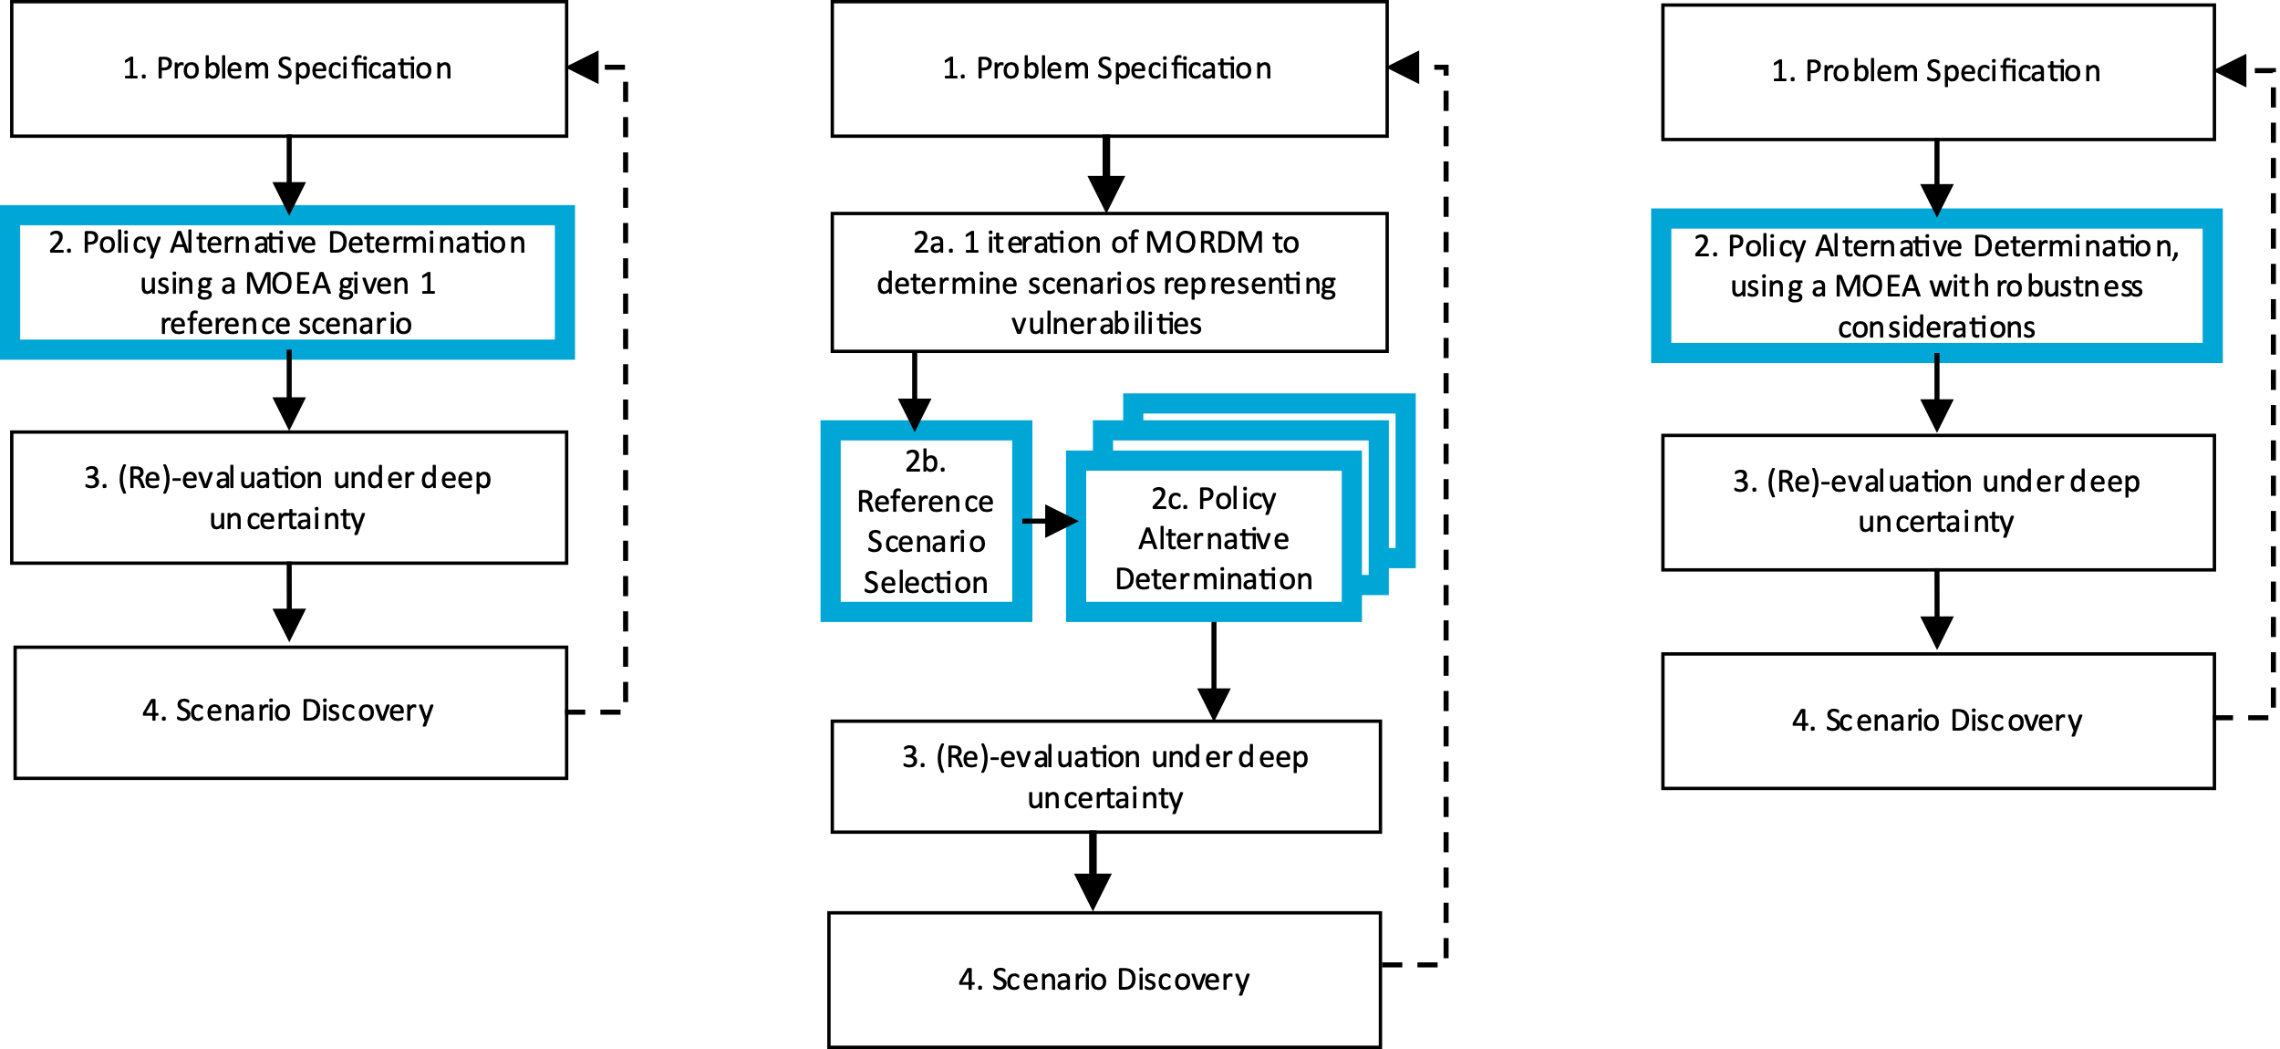
Robust decision making frameworks

Slide 45
Problematize optimization in light of value diversity

Slide 46
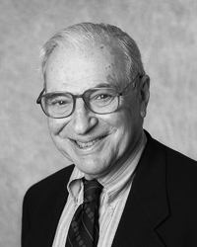
Arrow’s impossibility theorem
Kenneth Arrow, in 1950, demonstrated that there is no perfect voting procedure, it is either dictatorial or inherently unfair.

Slide 47
Arrow’s impossibility theorem
Individual preferences are ranked preferences (i.e. ordinal utility)
$A≻B≻C$
The goal is to arrive at an aggregate preference order of options given the individual preferences

Slide 48
Arrow’s impossibility theorem
Any voting procedure should be
1) Non-dictatorial: there is no single individual who’s preferences determine the aggregate preferences
2) Universal (complete ranking and deterministic): the final aggregate ranking should be complete, so no ties, and given a particular set of preferences of individuals always produce the same aggregate ranking
3) Independence of irrelevant alternatives: the preference relation between options A and B should not change if an option C is introduced which is always ranked lower than A and B
4) Pareto efficient: if option A is preferred by every individual over option B, than in the aggregate ranking option A should also be preferred over option B

Slide 49
Battling Arrow’s paradox
How can we account for Arrow’s paradox in any policy analytic activity?
Work with multiple objectives
Avoid the temptation to produce a complete ranking
Explore over alternative ways of formulating / framing a problem
Explore over alternative ways of aggregating over time and over scenarios
Key message: the policy analytic activity aims at helping decision makers understand the consequences of decision alternatives, and not to identify the best decision alternative

Slide 50
Pareto optimality
Premise: “A solution is Pareto optimal when improvements in one objective would degrade the performance in at least another objective”
Purpose: To rank alternatives in multi-objective problems.

Slide 51
Pareto dominance
When is a solution A better than a solution B, given that both A and B are scored on two criteria?
Dominance relation: option C dominates A and B because on all criteria it’s performance is better
A
Objective 2
B
C
Objective 1

Slide 52

Genetic Algorithms (GA)
Proposed in the 1970s by John Holland
Chromosome: Bit-string encoded candidate solution (nowadays other encoding forms are possible)
Gene: Each bit of the solution
A chromosome could represent the value of one or more parameters in your algorithm/system, e.g. the length of a robot arm, the value of weights in your neural network, the ids of operations you need to execute in a sequence…

Slide 53
John Holland—GA’s as Complex Adaptive Systems
Why simulate evolution for optimization?
Requires only distinguish “functional benefits” of adaptations
“Performance-based Random Process”: does not require detailed problem information (i.e., derivatives) and all pathways may be reachable
Breadth of application (real/discrete choices, uncertainty, nonlinearity)
Simple to link to complex simulations

Slide 54
Basic structure of an MOEA
population = initialize_population(population_size)
evaluate_objective_function(population)
non_dominated_sort(population)
selected = select_parents(population, population_size)
children = crossover_and_mutate(selected, p_crossover,p_mutation)
while(not stopping_condition()):
evaluate_objective_function(children)
union = population+children
non_dominated_sort(union)
selected = select_parents(union, population_size)
population = children
children = crossover_and_mutate(selected, p_crossover, p_mutation)

Slide 55
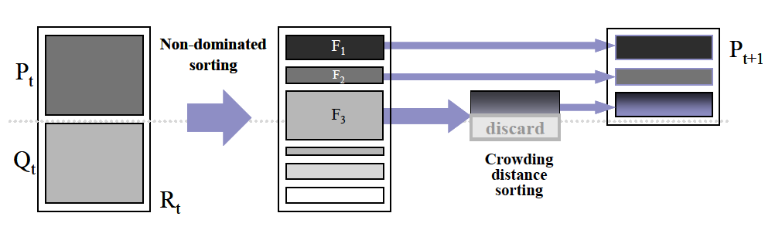
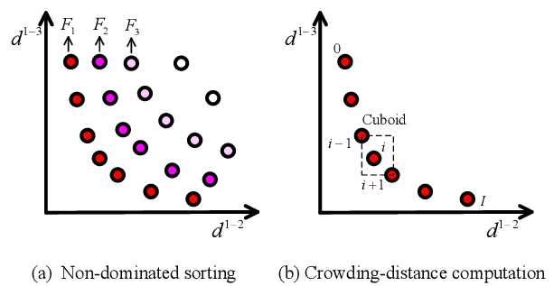
NSGAII (classic, but outdated)
1) Initial population
3) Rank the fitness of the population
Parent
population
2) Genetic
Operators:
Selection+
Mutation+
Crossover
Offspring
population
Key components:
1) Non dominated sorting
2) Crowding indicator for diversity maintenance

Slide 56
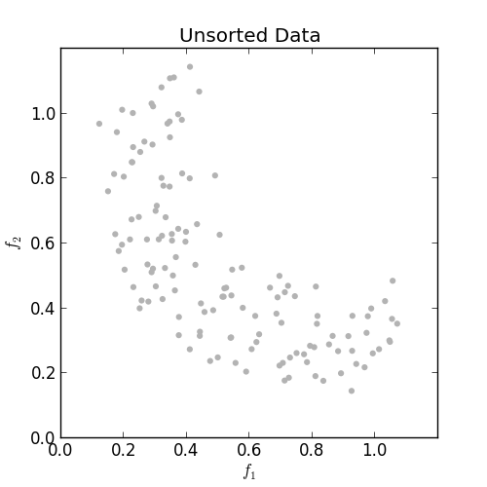
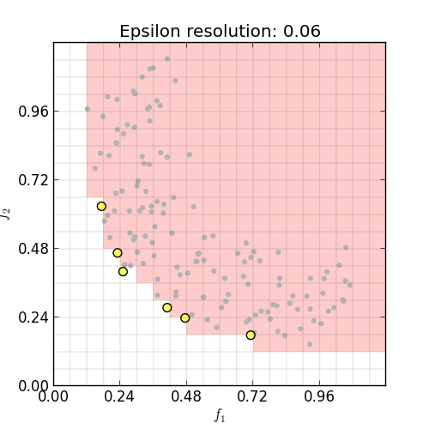
Epsilon dominance- better alternative to preserve diversity and scalability
Keeps the solution bounded and stable (important when increasing dimensionality)
Preserve diveristy
Taken from https://github.com/matthewjwoodruff/pareto.py

Slide 57
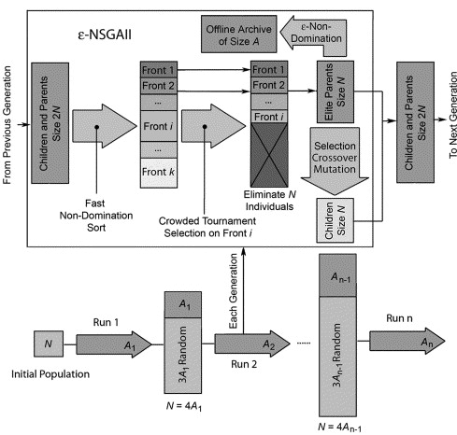
EPSILON-NSGAII
Key components:
Epsilon dominance for diversity maintenance
2) Auto-adaptive population sizing

Slide 59
MORDM excercise

Slide 60
Explanation of the shallow lake problem

Slide 61
Go through steps
So how to connect model to workbench
Do basic exploration
Do optimization?
Go to re-evaluation

Slide 62
Robustness metrics

Slide 63
McPhail, C., et al (2018). "Robustness metrics: How are they calculated, when should they be used and why
do they give different results?" Earth's Future. 10.1002/2017EF000649

Slide 64
Robustness metrics
deeply uncertain factor 1
deeply uncertain factor 2
deeply uncertain factor 3
KPI’s per
scenario
Distribution per kpi over scenarios
policy
How to summarize the distribution over scenarios in (preferably) one number?
Robustness per kpi, or one robustness number per policy?
Figure adapted from Trindade et al. (2019) https://doi.org/10.1016/j.advwatres.2019.103442

Slide 65
3 families of robustness metrics
Satisficing robustness
Absolute: the observed performance of a policy in each scenario compared to an absolute performance threshold
Regret
Relative: the difference between the observed performance of a policy in each scenario and the performance of some reference policy for each scenario
Descriptive statistics
Characterizing the distribution of performance of a policy over the set of scenarios using one or more moments of the distribution

Slide 66
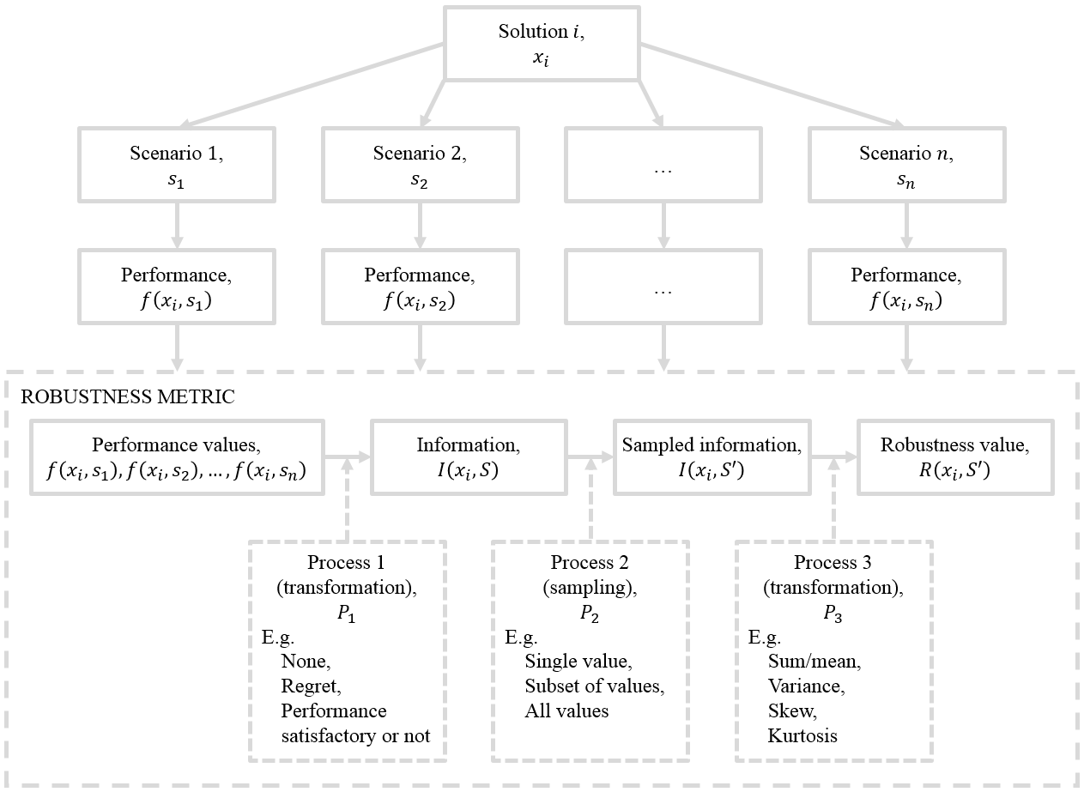
Robustness calculation
McPhail, C., et al (2018). "Robustness metrics: How are they calculated, when should they be used and why
do they give different results?" Earth's Future. 10.1002/2017EF000649

Slide 68
MORDM exercise continued

Slide 69
Some example applications of (MO)RDM

Slide 70
Colorado compact

Slide 71
Research traingle

Slide 73
Closing remarks

Slide 74
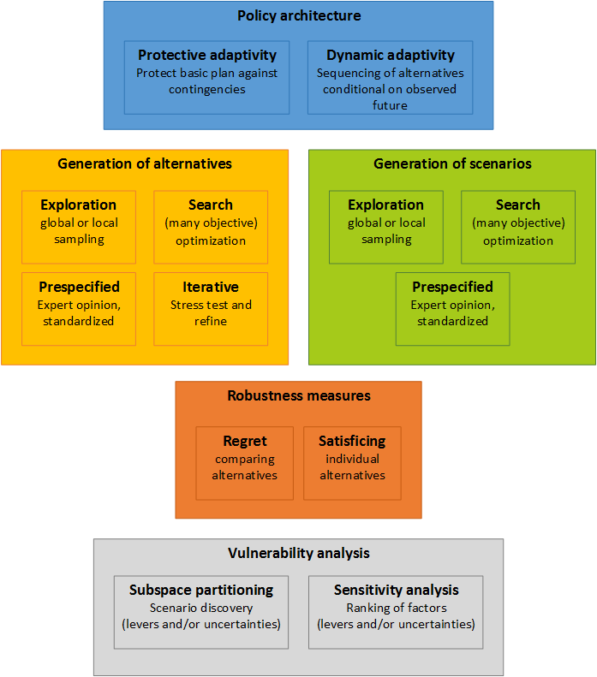
Kwakkel & Haasnoot (2018) Supporting decision making under deep uncertainty: a synthesis of approaches and techniques

